Slide 1
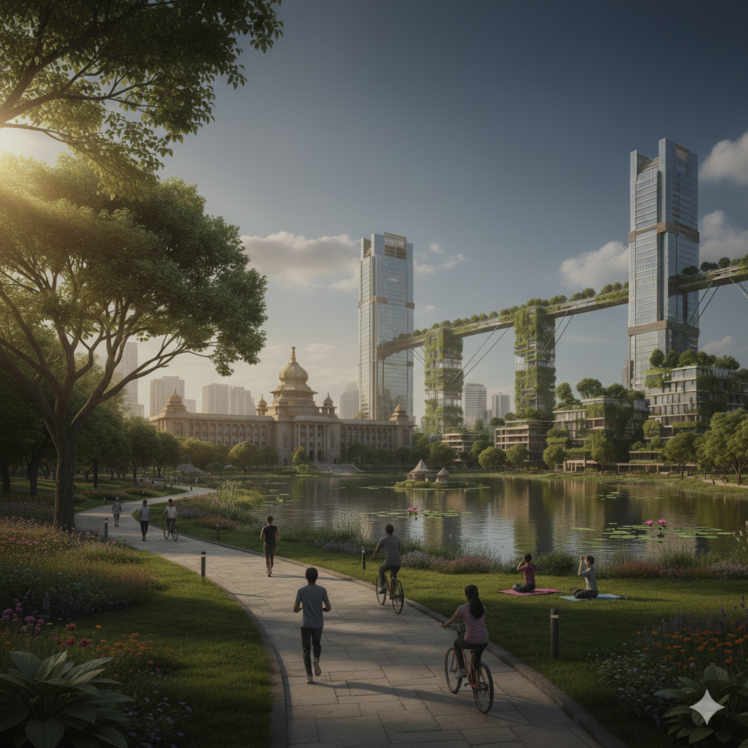
NASA Space Apps Challenge 2025
Case Study: Bangalore, India Challenge: Data Pathways to Healthy Cities and Human Settlements Team: Code4Planets | Lead: Deepika M 'Turning Data into Action for Healthy and Resilient Cities'

Slide 2
Objectives
Use NASA Earth Science data + local data
Improve quality of life in Bangalore
Focus domains: Waste, Water, Climate
Apply Data Analytics + ML + IoT + Civil Solutions
Involve city leaders & citizens in planning

Slide 3
Data Sources
BBMP – Bruhat Bengaluru Mahanagara Palike Municipal body providing waste generation and treatment data.
BWSSB – Bangalore Water Supply and Sewerage Board Water quality monitoring data from rivers and lakes (2021).
NASA POWER – Prediction Of Worldwide Energy Resources Provides climate parameters (temperature, solar radiation, rainfall).
CPCB – Central Pollution Control Board Air quality data (PM2.5, PM10, NO₂, Ozone) for 2020–2024.
Methodology
Data Cleaning & Integration Standardizing different datasets into a common framework.
Risk Analysis Identifying environmental risks from untreated waste, polluted water, and poor air quality.
ML Risk Prediction Using Machine Learning to forecast hotspots and future environmental risks.
IoT Prototypes Designing smart sensors for real-time monitoring (waste, water, climate).
Civil Engineering for Resilience Implementing long-term structural solutions like STPs, cooling centers, and stormwater drains.

Slide 4
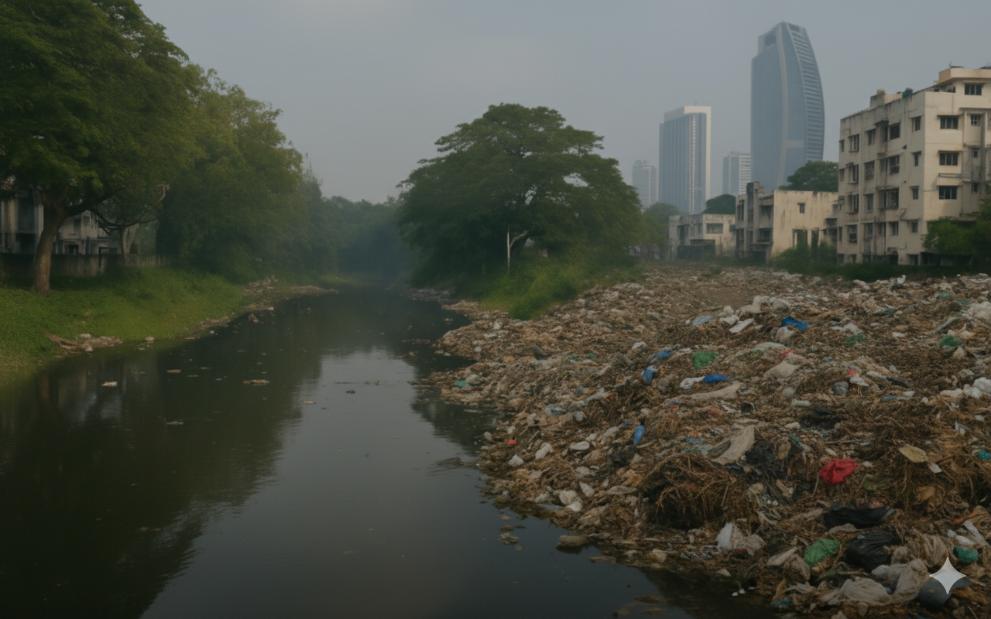

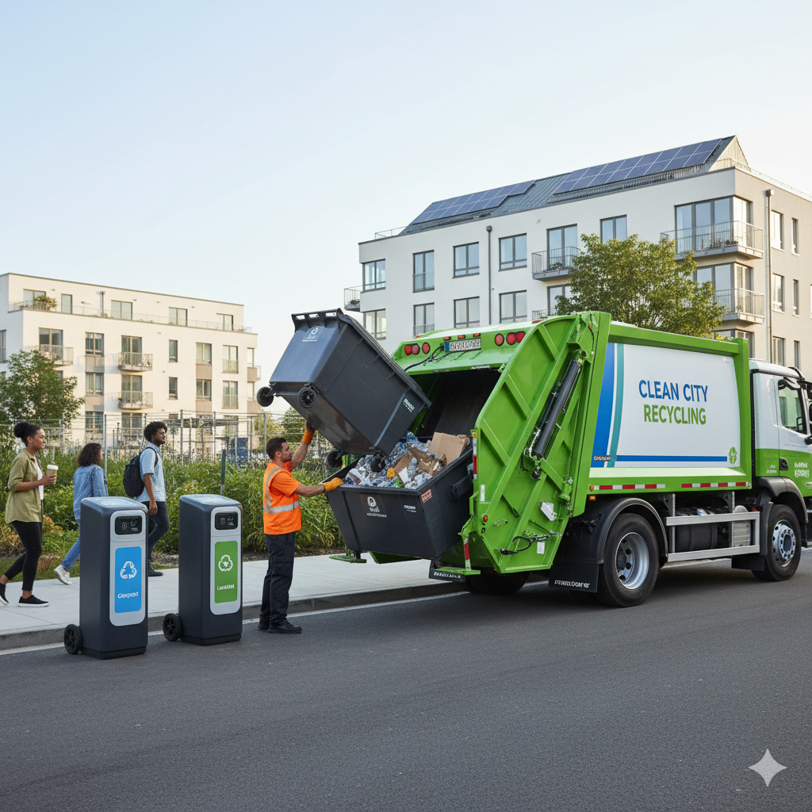
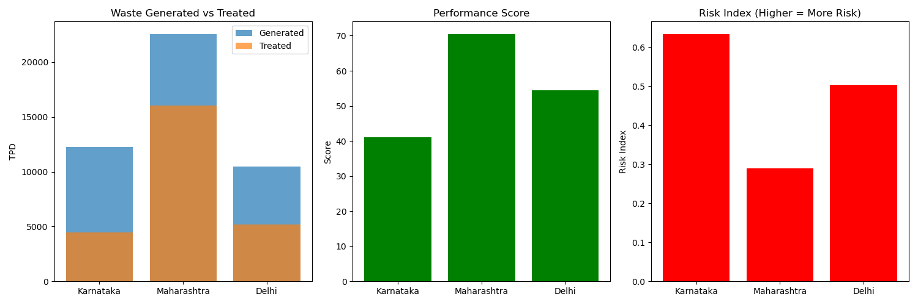
Waste Domain
Findings: - 12,258 TPD (Tons Per Day)waste generated; only 37% treated - Risks: Sanitation, methane emission, disease spread ML Risk Factor: High untreated waste = disease/fire hazard
Solutions: - IoT: Smart bins, GPS trucks - ML: ML model identifies untreated waste risk zones — forming the base for predicting landfill overflow hotspots - Civil: Waste-to-energy, compost hubs(local organic waste processing centers)

Slide 5
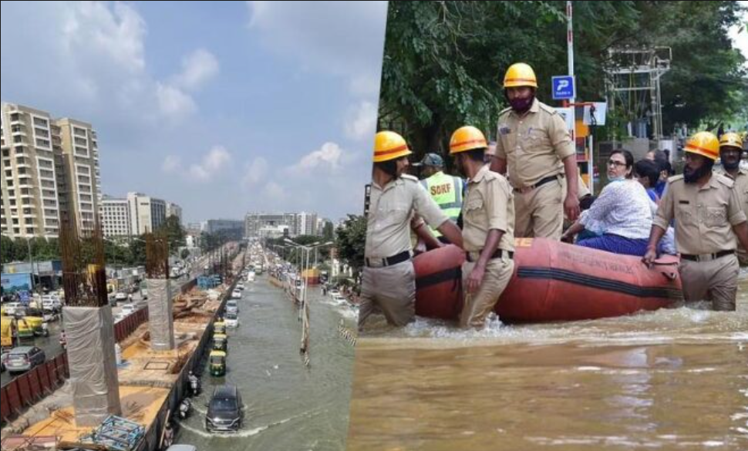
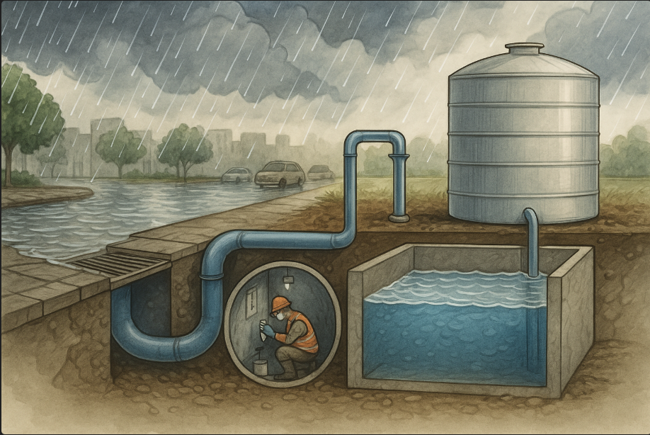
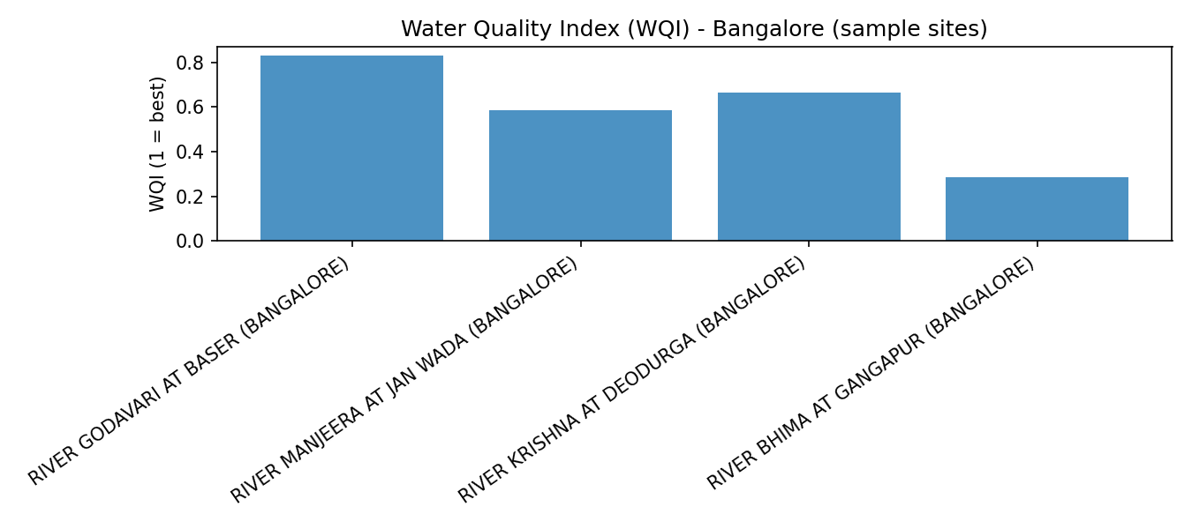
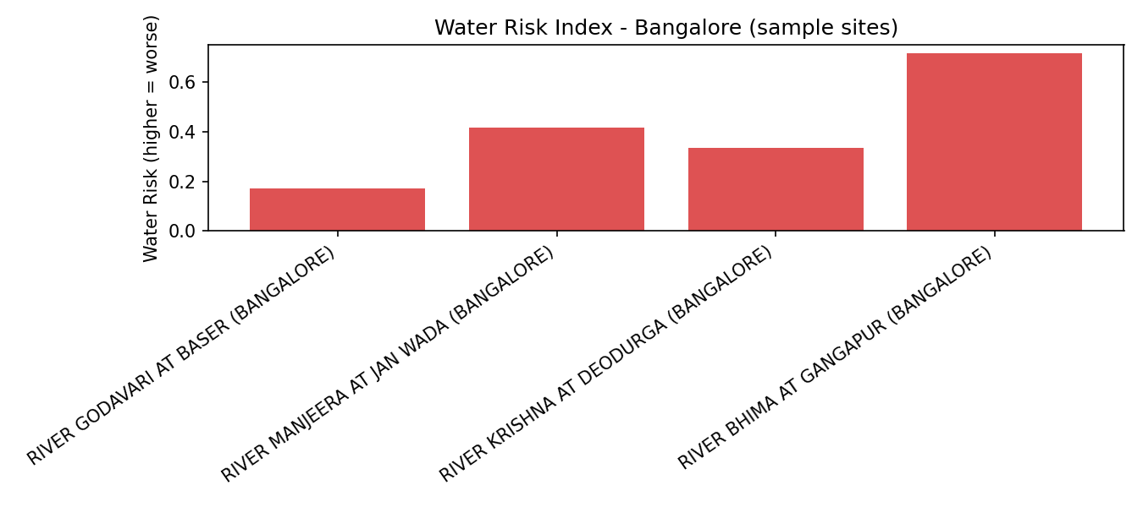
Water Domain
Findings:
High BOD (Biochemical Oxygen Demand 2–3 mg/L), unsafe coliform levels Unsafe drinking water, flood contamination risks
ML Risk Factor: Current model analyzes water quality trends and can be scaled to predict contamination spikes during monsoon using rainfall and BOD data correlations.
Solutions:
- IoT: Water quality sensors - Civil: Decentralized STPs(Sewage Treatment Plants) near lakes - Policy: BWSSB(Bangalore Water Supply and Sewerage Board) + Health Dept. campaigns

Slide 6
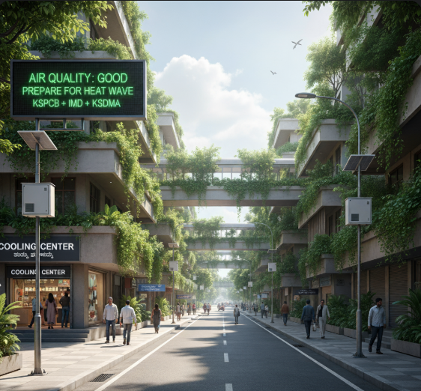

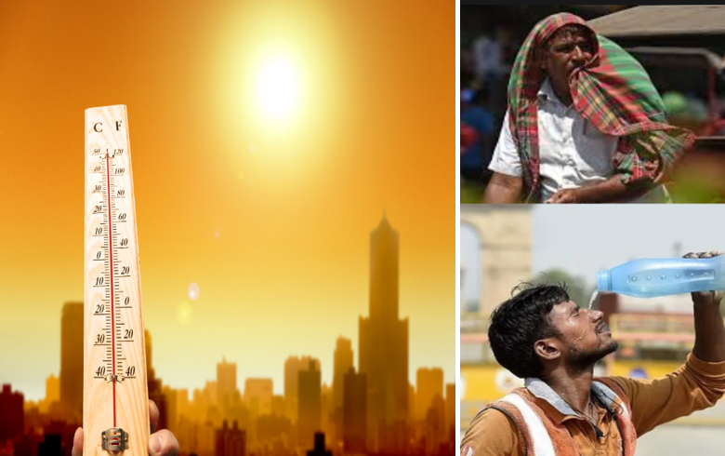
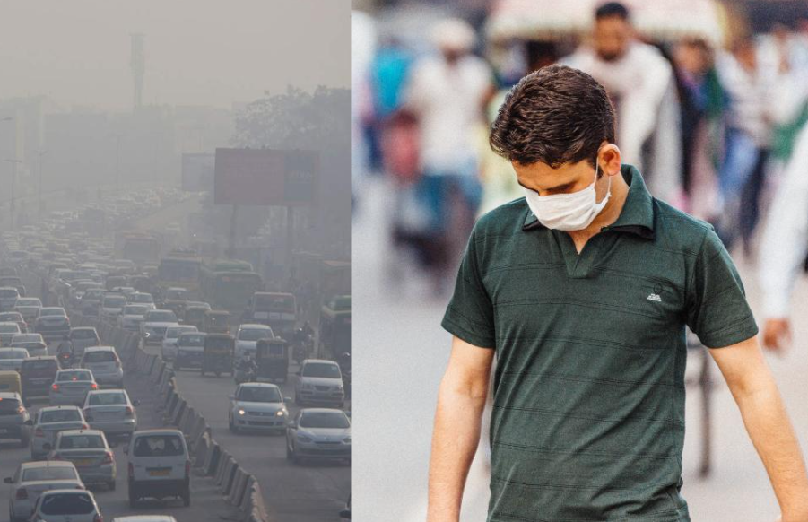
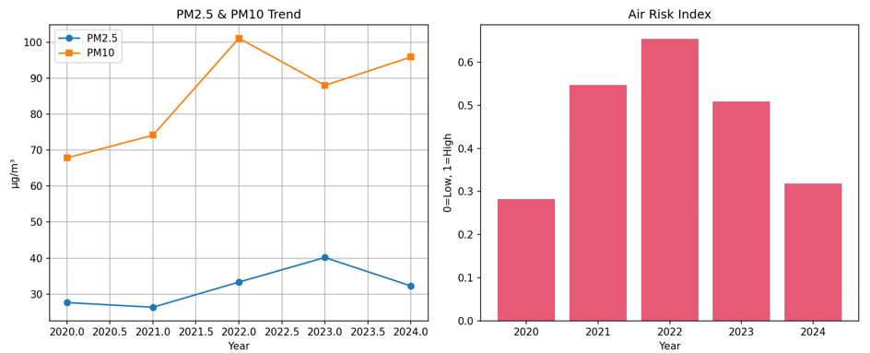
Climate Domain
Findings (2020–2024):
- Rising PM2.5/PM10, Air Risk Index ~0.55 - ML:Analyzes NASA & CPCB data — scalable to predict air pollution and heatwave risks.
Solutions:
- IoT: Heat & flood early warning systems - Civil: Cooling centers, green corridors, storm drains - Policy: KSPCB((Karnataka State Pollution Control Board) + IMD + KSDMA alerts

Slide 7
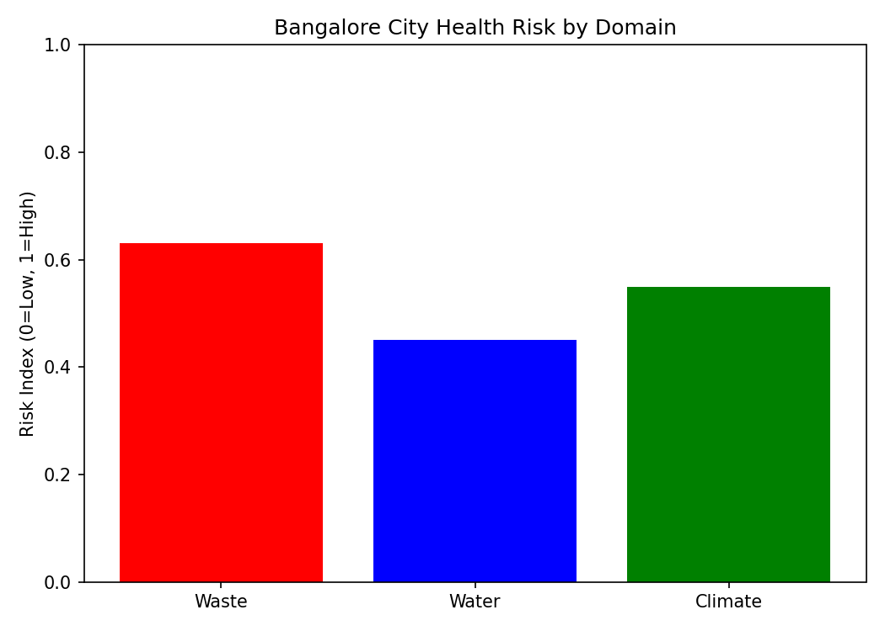
City Health Score & Vision
Bangalore Health Risk Score ~0.45 (moderate risk) - Waste: 0.63 | Water: 0.45 | Climate: 0.55 Smart City Vision: - AI/ML: Predict risks - IoT: Real-time alerts - Civil: Waste-to-energy, STPs, corridors - Citizens: Apps for reporting & monitoring
'Healthy Cities = Healthy People + Healthy Planet'

